Slide 1
Affinity Diagrams for User Research Analysis

Slide 2
Why do we use this Affinity Diagram
In thematic analysis, researchers aim to make sense of all the user research notes and observations they made by creating themes to further organize and explain what they learned
Naturally an affinity diagram is a tool generally used to create groups and themes from user research data since it is an effective way to categorize qualitative data!

Slide 3
Themes from user research are entirely dependent on your research and goals. Here are some examples and ideas for creating useful themes from your UX research data:
Answers to specific research questions
Frequently seen or heard topics/ideas
Summary of related notes, observations and data

Slide 4
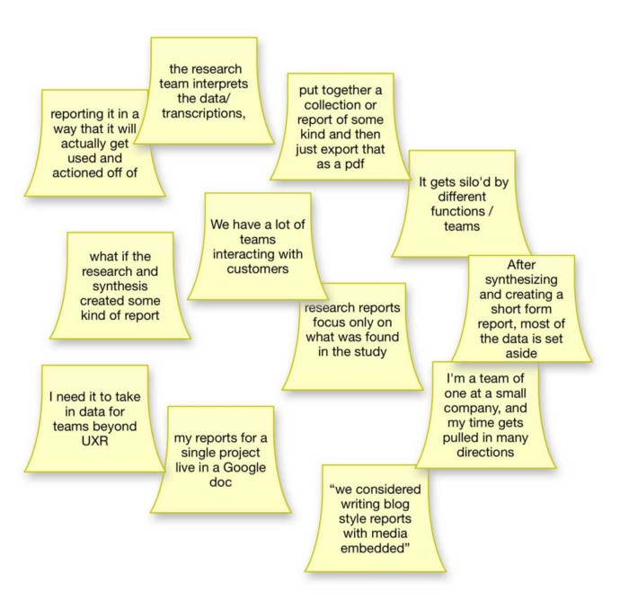
Steps to create an Affinity Diagram
1° Record all notes or observations on individual cards or sticky notes
Tip: Put pieces of data, small documented facts, drawings, ideas, and observations onto post-it notes, cards, or pieces of paper and put them up on wall charts

Slide 5
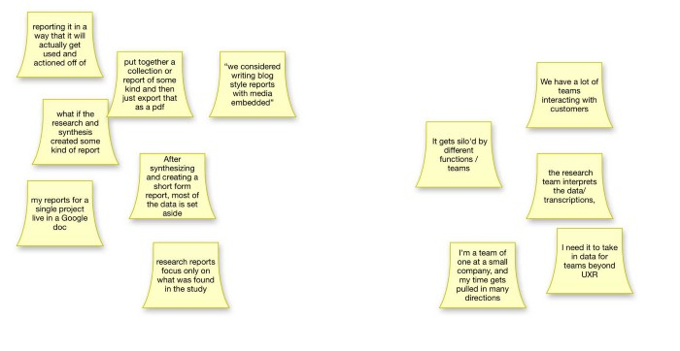
Steps to create an Affinity Diagram
2° Look for patterns and notes or observations that are related and create a group for each pattern or theme
Tips: Take a post-it and ask, “Is this similar to the first one or is it different?”. Then, you will place it in the first group or into its own group.

Slide 6
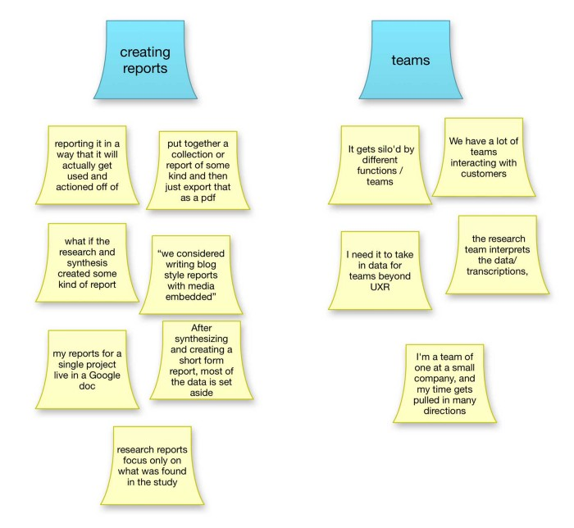
Steps to create an Affinity Diagram
3° Give each of those groups a name or label to represent what that group means
Tip: Rank the most important clusters over less important clusters. Be aware which values, motives, and priorities you use as foundation ideas before you start ranking: Is this your user’s priorities, your company’s, the market’s, the stakeholder’s, or your own? Which ones should you put most emphasis on?

Slide 7
Reference
https://zacknaylor.medium.com/how-to-create-an-affinity-diagram-for-ux-research-cdc08489952d
https://www.interaction-design.org/literature/article/affinity-diagrams-learn-how-to-cluster-and-bundle-ideas-and-facts

